Slide 1
Parallel Processing
Belle Peng
Sept 04, 2018

Slide 2
Notes:
Submit multiple processes that can run independently from each other in order to make best use of our CPU cores.

Slide 3
PROCESSES | THREADS
Processes can have multiple threads | Threads are like mini-processes that live inside a process
Two processes can execute code simultaneously in the same python program | Two threads cannot execute code simultaneously in the same python program (although there are workarounds*)
Don't share memory Therefore, sharing information between processes is slower | Share memory Therefore, sharing information between threads is faster
Have more overhead than threads as opening and closing processes takes more time | Spawning/switching threads is less expensive
Processes require more resources | Threads require fewer resources (are sometimes called lightweight processes)
No memory synchronisation needed | You need to use synchronization mechanisms to be sure you're correctly handling the data
Notes:
A process is an instance of program (e.g. Jupyter notebook, Python interpreter). Processes spawn threads (sub-processes) to handle subtasks like reading keystrokes, loading HTML pages, saving files. Threads live inside processes and share the same memory space
The reason why processes aren't enough is because applications need to be responsive and listen for user actions while updating the display and saving a file
Processes speed up Python operations that are CPU intensive because they benefit from multiple cores and avoid the GIL.
Threads are best for IO tasks or tasks involving external systems because threads can combine their work more efficiently. Processes need to pickle their results to combine them which takes time.
Threads provide no benefit in python for CPU intensive tasks because of the GIL.

Slide 4
Concurrent vs. Parallel
Multiprocessing – parallel
Threading – Concurrent
concurrent.futures – using a ThreadPoolExecutor. We're going to submit tasks to the pool and get back futures, which are results that will be available to us in the future.
Dask – Shown later in this demo
Greenlets – even less expensive to create than threads.
gevent – execution that can be scheduled collaboratively and can perform tasks concurrently without much overhead.
Celery – A high-level distributed task queue. The tasks are queued and executed concurrently using various paradigms like multiprocessing or gevent.
Notes:
Concurrent is not Parallel
Concurrent – Scheduling independent code to be executed in a cooperative manner.
Take advantage of the fact that a piece of code is waiting on I/O operations, and during that time run a different but independent part of the code.
Can achieve lightweight concurrent behaviour via greenlets. Because of that, greenlets are heavily used for performing a huge number of simple I/O tasks, like the ones usually found in networking and web servers.

Slide 5
Demo

Slide 6
Dask DataFrame

Slide 7
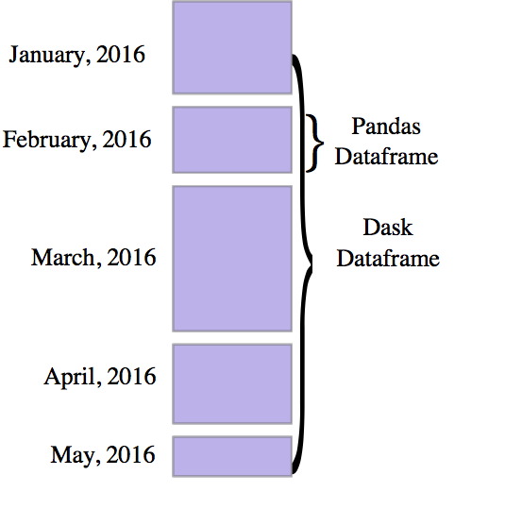
What is Dask Dataframe?
Dask.dataframe is used in situations where Pandas is commonly needed, but when Pandas fails due to data size or computation speed.
Notes:
A Dask DataFrame is a large parallel dataframe composed of many smaller Pandas dataframes, split along the row-wise index.
These pandas dataframes may live on disk for larger-than-memory computing on a single machine, or on many different machines in a cluster.
One Dask dataframe operation triggers many operations on the constituent Pandas dataframes.
Lazy Algorithm – need to type compute()
a way to speed up Data Analysis in Python, without having to get better infrastructure or switching languages.
Dask provides high-level Array, Bag, and DataFrame collections that mimic NumPy, lists, and Pandas but can operate in parallel on datasets that don’t fit into main memory. Dask’s high-level collections are alternatives to NumPy and Pandas for large datasets.

Slide 8
Uses
Anti-Uses
Distributed computing on large datasets with standard Pandas operations like groupby, join, and time series computations
Accelerating long computations by using many cores
Dask can scale to a cluster of 100s of machines. It is resilient, elastic, data local, and low latency.
If your dataset fits comfortably into RAM on your laptop then use parallelism instead.
If your dataset doesn’t fit neatly into the Pandas tabular model then you might find more use in dask.bag or dask.array
If you need functions that are not implemented in Dask dataframe then you might want to look at dask.delayed which offers more flexibility.
If you need a proper database with all that databases offer you might prefer something like Postgres
Notes:
try this Framework out next time you have to process a Dataset locally or from a single AWS instance. It’s pretty fast.

Slide 9
Fast
Slow
Elementwise operations: df.x + df.y, df * df
Row-wise selections: df[df.x > 0]
Loc: df.loc[4.0:10.5]
Common aggregations: df.x.max(), df.max()
Is in: df[df.x.isin([1, 2, 3])]
Datetime/string accessors: df.timestamp.month
groupby-aggregate
value_counts: df.x.value_counts()
Drop duplicates: df.x.drop_duplicates()
Join on index
Datetime resampling: df.resample(...)
Rolling averages: df.rolling(...)
Pearson Correlations: df[['col1', 'col2']].corr()
Operations requiring a shuffle
Set index: df.set_index(df.x)
groupby-apply not on index (with anything): df.groupby(df.x).apply(myfunc)
Join not on the index: dd.merge(df1, df2, on='name’)
The Pandas API is very large. Dask dataframe does not attempt to implement many Pandas features or any of the more exotic data structures like NDFrames
Operations that were slow on Pandas, like iterating through row-by-row, remain slow on Dask dataframe

Slide 10
Example

Slide 11

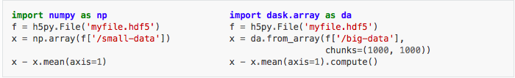
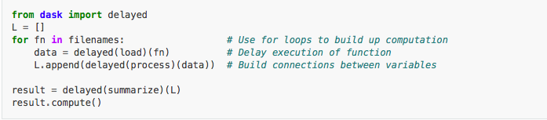
>>> import dask.dataframe as dd
>>> dd = ddf.from_pandas(df, npartitions=N)
>>> df.npartitions
Ex: If you have 4 cores, make 8 partitions.

Slide 12
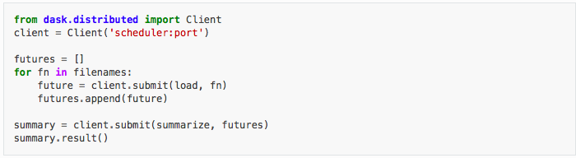

Slide 13
Resources
https://sebastianraschka.com/Articles/2014_multiprocessing.html
https://code.tutsplus.com/articles/introduction-to-parallel-and-concurrent-programming-in-python--cms-28612
https://medium.com/@bfortuner/python-multithreading-vs-multiprocessing-73072ce5600b
https://dbader.org/blog/python-parallel-computing-in-60-seconds
http://dask.pydata.org/en/latest/dataframe.html

